Slide 1
딥러닝 스터디
2019
2019 .03. 08

Slide 2
Autonomous Driving
CONTENTS
1 경사하강법
2 역전파 알고리즘
3 전반적인 CNN 원리

Slide 3
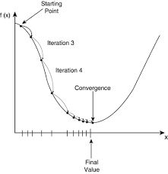
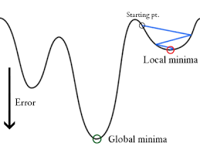
1 경사하강법
확률적 경사하강법
모멘텀 경사하강법

Slide 4
class SGD:
def __init__(self, lr=0.01): //lr(학습률)
self.lr = lr
def update(self, params, grads):
for key in params.keys():
params[key] -= self.lr * grads[key]
(optimizer = tf.train.GradientDescentOptimizer(learning_rate=0.01)
train = optimizer.minimize(cost)
<경사 하강법 코드>
class Momentum:
def __init__(self, lr=0.01, momentum=0.9):
self.lr = lr
self.momentum = momentum
self.v = None # velocity
def update(self, params, grads):
if self.v is None:
self.v = { }
for key, val in params.items():
self.v[key] = np.zeros_lie(val)
for key in params.keys():
self.v[key] = self.momentum * self.v[key] - self.lr * grads[key]
params[key] += self.v[key]
def train(loss):
optimizer = tf.train.MomentumOptimizer(learning_rate=0.01, momentum=0.9)
train = optimizer.minimize(loss)
return train
<모멘텀 경사 하강법>

Slide 5
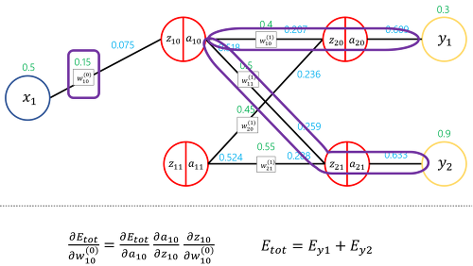
2 역전파 알고리즘
https://gomguard.tistory.com/182

